Slide 1
A quick glance at Computer Science
Alberto Tonda, Ph.D., Senior permanent researcher (DR)
UMR 518 Mathématiques et Informatique Appliquées - PS, INRAE, U. Paris-Saclay UAR 3611 Institut des Systèmes Complexes Paris Ile-de-France, CNRS
alberto.tonda@inrae.fr

Slide 2
Outline
This is some text
And some smaller text

Slide 3
Computer science
What is computer science?
Computer science is the study of computation, information, and automation. It explores theoretical principles underlying algorithms, logic, and complexity; and practical design and implementation of hardware and software systems. CS seeks to formalize problem-solving, optimize efficiency, and develop intelligent systems that interact with the world. (ChatGPT)
Some people claim it’s not science, it’s engineering
“Can you do computer science without a computer?”
(Italy) Curriculum differences CS/CSE are minimal
I share this point of view, but it’s not entirely correct

Slide 4
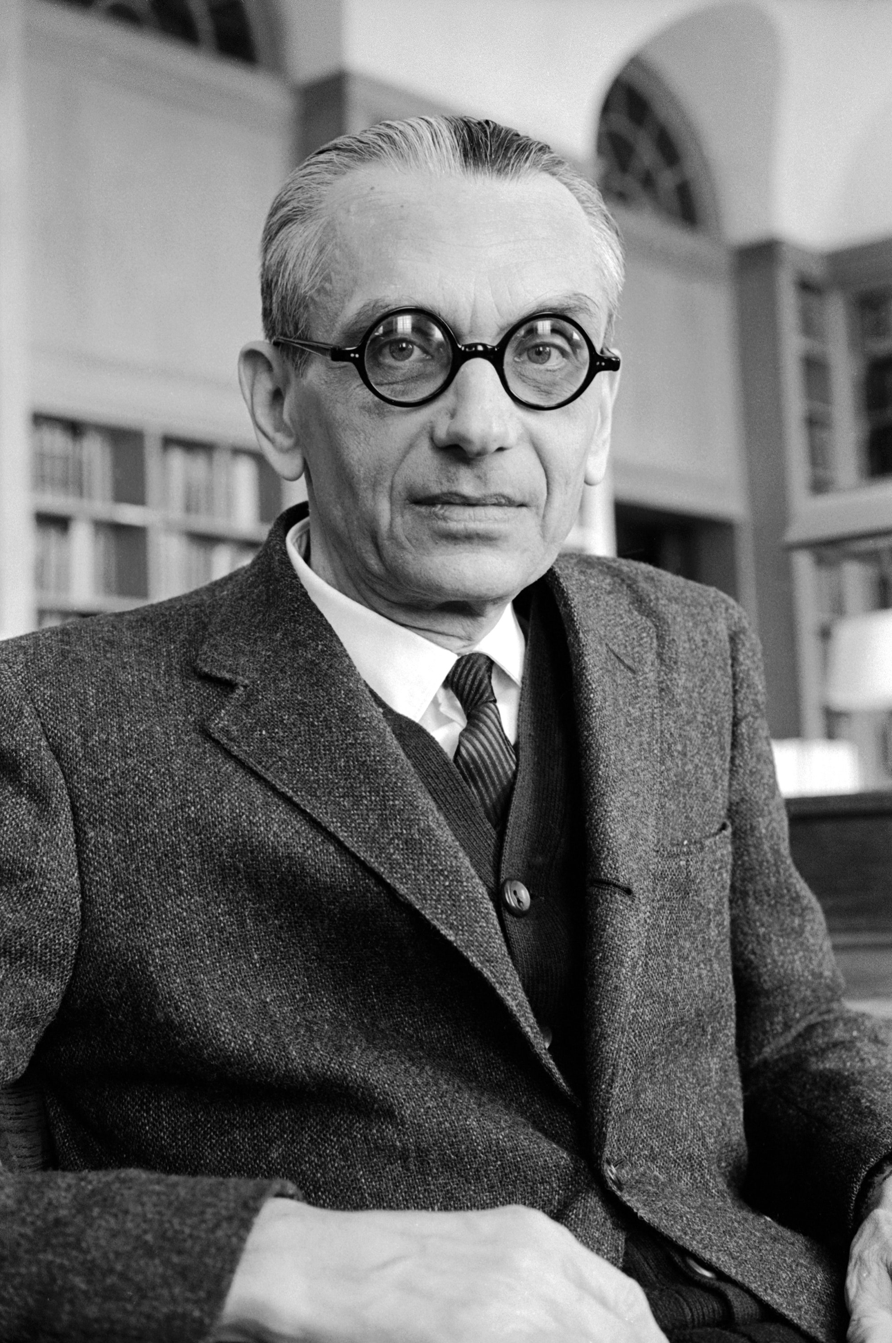
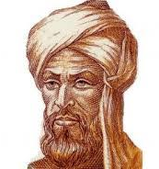
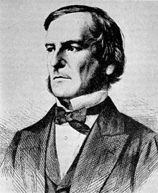
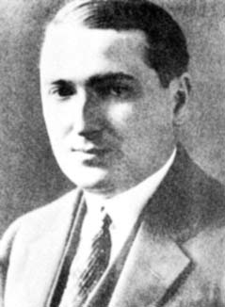
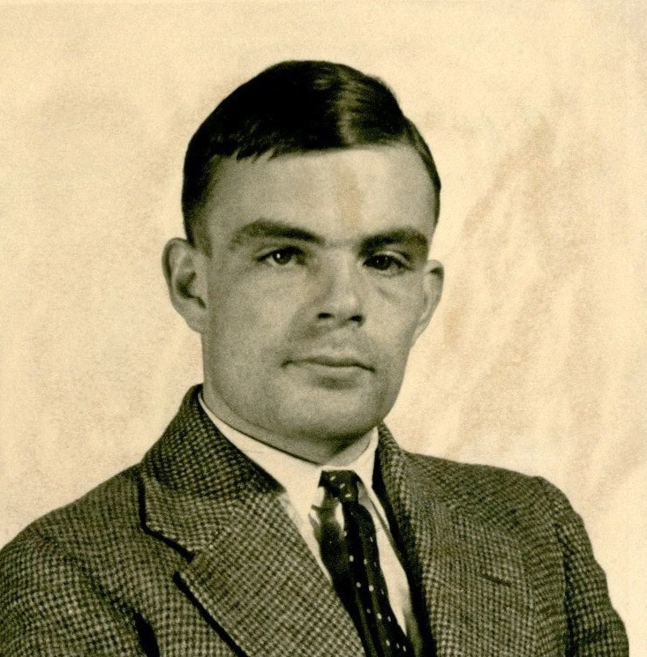
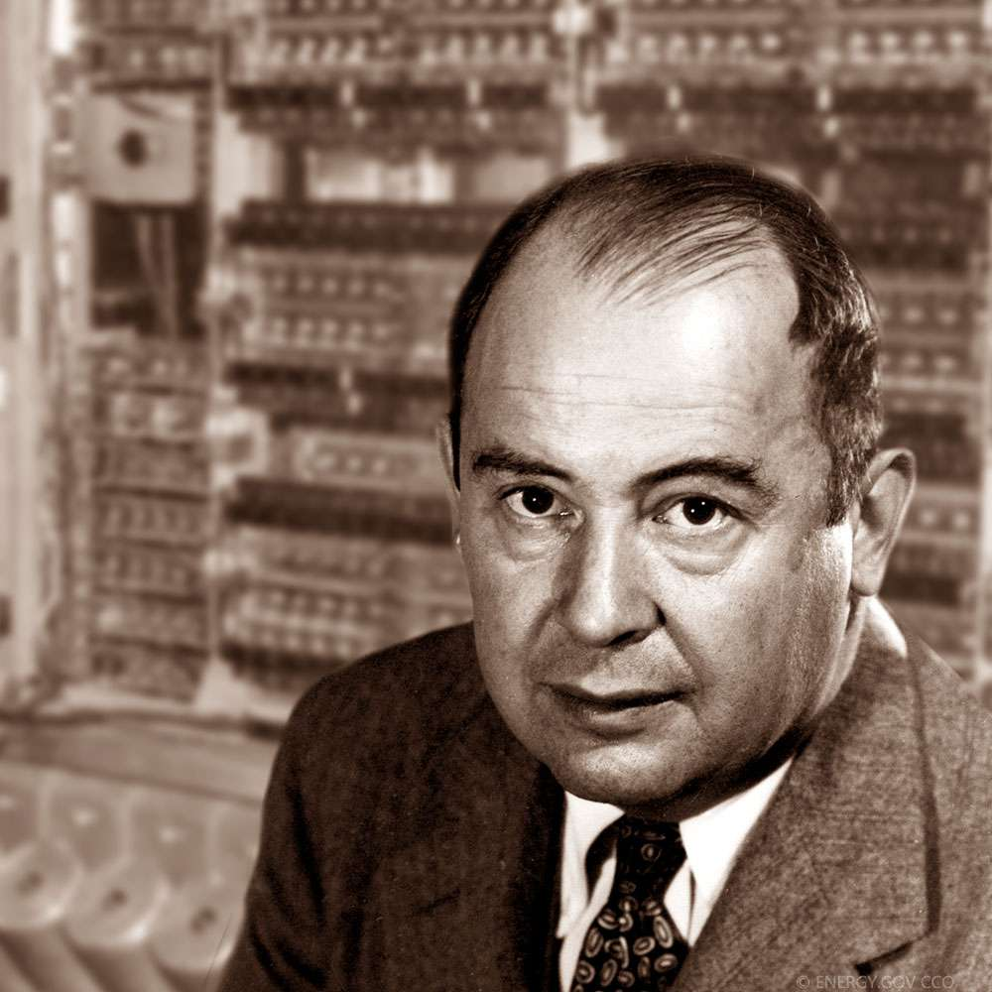
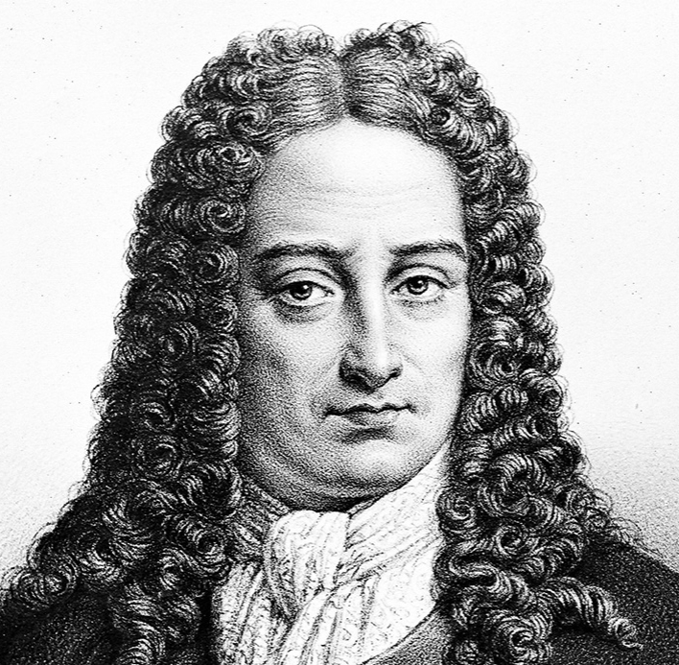

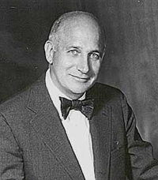
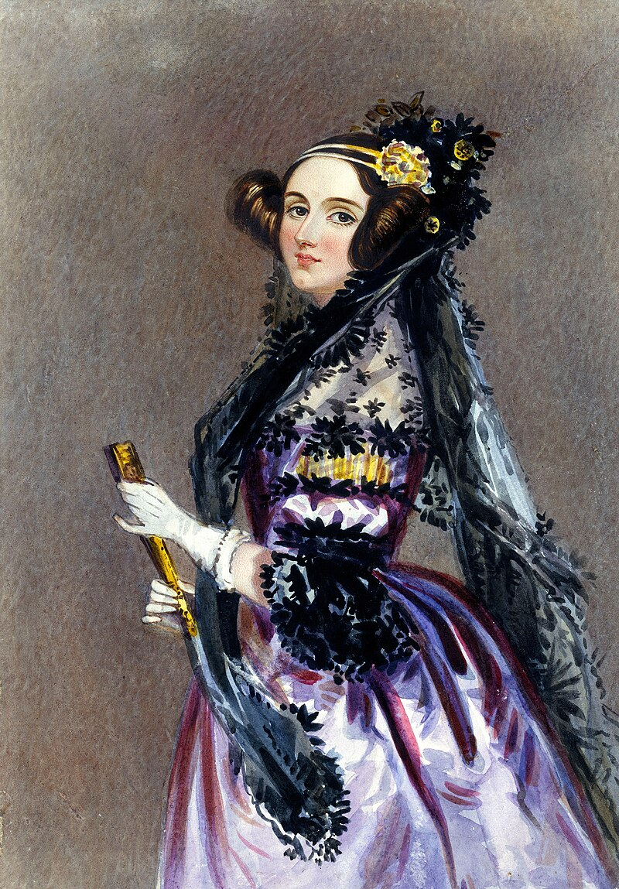
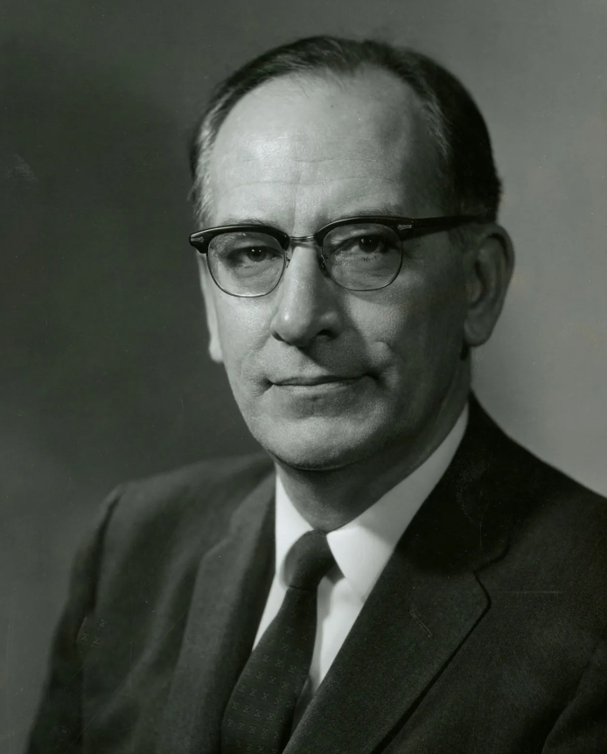
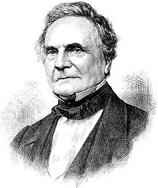

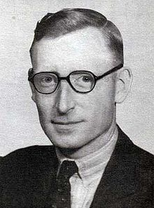
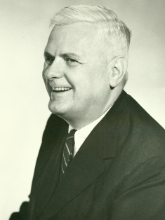

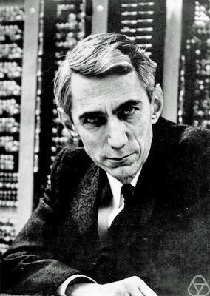
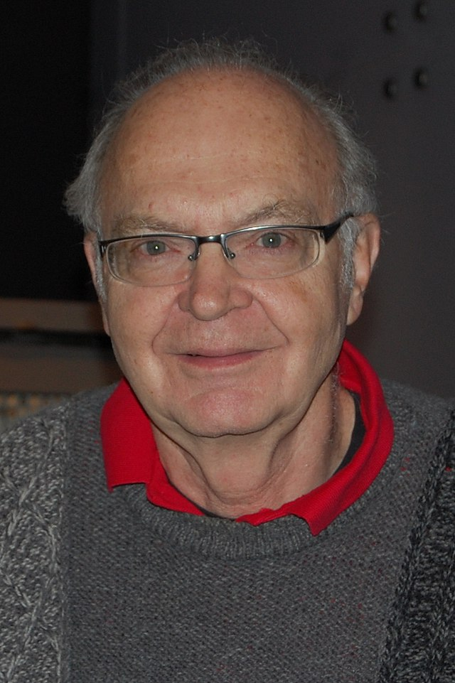
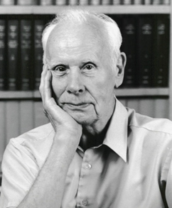
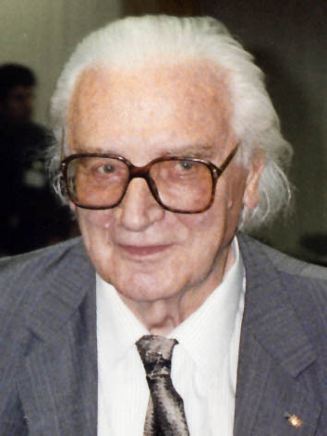
Computer science
Pre-computer science
K. F. Gödel
M. Al-Khwarizmi
G. Boole
E. Post
G. W. von Leibniz
J. P. Eckert
Alan Turing
John Von
Neumann
A. Lovelace
J. Mauchly
C. Babbage
T. Flowers
Claude Shannon
Alonzo Church
Grace Hopper
Donald Knuth
G. Stibiz
K. Zuse

Slide 5
What are the 3 fundamental parts of a computer?

Slide 6
What are the 3 fundamental parts of a computer?
Disk storage (hard drive)
Computation (Central Processing Unit, CPU)
Temporary memory (Random Access Memory, RAM)
When programs are executed
Loaded from hard drive to RAM
CPU reads and writes information from/to RAM*
Eventually, results might be written back to hard drive
*There are also intermediate memories, like cache, but that’s not too important

Slide 7
Why should we care?
RAM data is volatile, hard drive data persists
Why does RAM exist, then?

Slide 8

Why should we care?
RAM data is volatile, hard drive data persists
Why does RAM exist, then?
Access to RAM is F A S T E R (by orders of magnitude!)
Reading and writing to hard drive is slow

Slide 9
Practical advice
Avoid reading and writing to/from disk more than necessary
Ideally, load everything at the beginning, write at the end
However, we might want to save intermediate results
You can improve speed by using more RAM
For example, store results of computations (no recomputing)
However, your amount of RAM is limited (out of memory errors)
OOM errors are the most common errors I got
Memory/CPU trade-off

Slide 10
Memory management
Everything in a computer is stored as…?

Slide 11
Memory management
Everything in a computer is stored as bits! 0/1
One single element is a bit, 8 bits make a Byte (octet)
If your RAM memory is 16 GB (GigaBytes), it means it can store up to 16 * 10^9 Bytes (and even more, using tricks)
Memory is now so large that minimal amounts are kB (10^3 Bytes)
Estimate or measure how much memory your program takes
E.g. in Python a float takes 8 Bytes (8*8=64 bits)
So you could store ~2 * 10^9 Python floats in RAM memory
But your operative system is also using memory; and so are all the other running programs, so in practice much less
Notes:
Open task manager here

Slide 12
Memory management
Computer memory is divided into “cells” (memory blocks)
Each block has its own address, and can store bits
Values inside variables are stored in blocks
Sometimes, references to blocks
a=12
 | 12
 |  |  | 13
b=13

Slide 13
Memory management
Memory management
Get rid of the stuff in memory you no longer use
Load new stuff in memory, properly
How do you do that in Python?

Slide 14
Memory management
Memory management
Get rid of the stuff in memory you no longer use
Load new stuff in memory, properly
How do you do that in Python?
YOU DON’T*
Python does that for you (garbage collector)
*however, the GC is not perfect, and you can invoke it manually
See the documentation of the gc Python package

Slide 15
Practical advice
Other languages allow for more precise control of memory
C, C++ (they are also called more low-level)
They are also much faster, but way more annoying
Screw up memory allocation -> program crashes (segmentation fault, aka “there is a problem somewhere”)
Memory leaks are also possible (do not release used memory)

Slide 16

Images
How much memory for an image?
745 x 1,134 x RGB, 1 Byte/channel

Slide 17
Images
How much memory for an image?
745 x 1,134 x RGB, 1 Byte/channel
You would expect something like 745 x 1,134 x 3 = 2,534,490 Bytes ~= 2.5 MB
But this image only takes ~105 KB!
How is that possible?

Slide 18
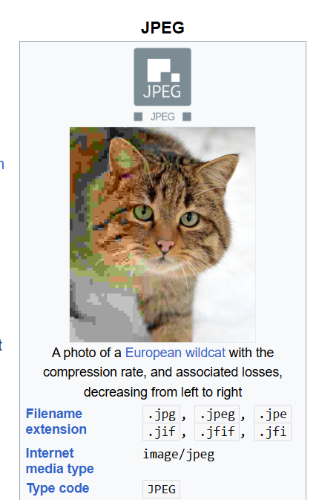
Images
Naïve encoding of images (BITMAP) is rare
JPG, PNG, WEBP are algorithms
You decompress a compressed image
Trade-off computation (de/compress) for memory

Slide 19
Why are some languages faster than others?
Fast languages
Assembly, C, C++, Fortran, …
Slow languages
Java, Python, R, …

Slide 20
Why are some languages faster than others?
Compiled languages (Assembly, C, C++, …)
Computers represent EVERYTHING as bits
Including instructions! But “000101010” is not very readable
Compilers transform human-readable programs into binary code
Binary code is optimized for your PC! So it’s very fast
Disadvantages
Compiling a program can take some time
Code works with restrictions (only Windows, only Linux, only Intel, only AMD, …)

Slide 21
Why are some languages faster than others?
Interpreted languages (Java*, Python, R, …)
Rely on software layer (interpreter) which reads and executes code
Same code can work on very different architectures!
Take care of memory management automatically; no compiling
Disadvantages
Interpreter adds extra steps for execution, it’s slower
Orders of magnitude slower (easily 10-100x)
Also, extremely difficult to optimize memory use and speed
*Java actually makes a hybrid compiled/interpreted mess

Slide 22
Python is interpreted, but…
Python is popular for its tricks to improve speed
Lots of Python libraries use a technique called binding
Compiled code is called and executed from Python code
So, the most time-consuming parts run faster!
Libraries like numpy, pytorch
In principle, you can also create bindings
It’s a bit hard, because it requires knowing well both Python AND the compiled language (usually C, C++, or Fortran)
A colleague (US LANL) did it for old Fortran code

Slide 23

Why should we care?
Sometimes code needs to be fast and Python is not enough
Example from the paper below
Simple code, running stochastic simulations
It needed to run thousands of times
C++ improved execution time 10-100x
Months to hours

Slide 24
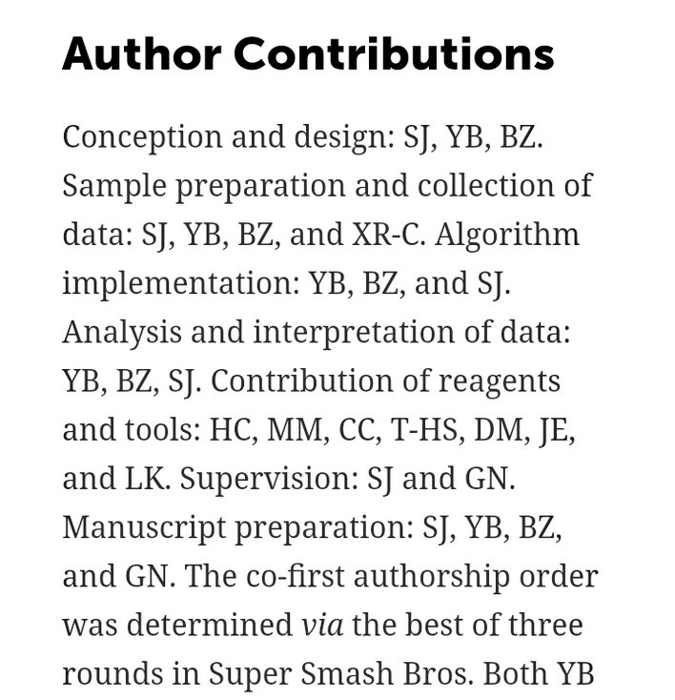
In conclusion
Computer Science is a relatively young field
Two souls: one more theoretical, the other more engineering
Tradition of anarchy and issues with authority (open source)
Maybe less “dogmatic” than other disciplines? IDK
We can easily rerun other people’s experiments!
Fast to adapt, CS changes really quickly over time
Computer Scientists think they are funny and witty

Slide 25
Questions?

